Slide 1
Biomarkers in Smokers
Annie Oh
BIOSTAT 214-Final Project
March 18, 2020

Slide 2
Introduction
Tobacco smoke is the most common environmental risk factor for chronic obstructive pulmonary disease (COPD).
Relationship between tobacco smoke and COPD may be related to toxins in tobacco
Pro-inflammatory state:
Airway mucus hyper-secretion
Bronchial wall thickening
Bronchoconstriction
Biomarkers of inflammation are increased in
Current and former smokers
Higher smoking-pack year history
Poor lung function

Slide 3
Goal
Identification of inflammatory biomarkers that are related to smokers may lead to early disease prediction and monitoring in the future.

Slide 4
Current proposed biological markers of COPD
Sputum mucin concentration
Plasma fibrinogen
C-reactive protein (CRP)
Soluble tumor-necrosis factor (TNF) receptors:
sTNF1a (also known as sTNF-R55)
sTNF1b (also known as sTNF-R75).

Slide 5
Why is this important?
Identification of inflammatory biomarkers related to smokers may lead to:
Early disease prediction
Disease monitoring

Slide 6
Study Population
SPIROMICS: SubPopulations and InterRmediate Outcomes Measures in COPD Study
Multi-center longitudinal cohort study
2900 participants (Never smokers and 20+ pack year smoking history)
Sub-population: Resmoke
Group 0: Never smokers
Group 1 (Resilient smoker): Preserved spirometry (FEV1/FVC ≥70%, FVC ≥ LLN) with NO evidence of symptoms or radiographic features of COPD
Group 2 (Non-resilient smoker): Preserved spirometry (FEV1/FVC ≥70%, FVC ≥ LLN) WITH evidence of symptoms or radiographic features of COPD
Group 3: COPD GOLD Stage 1
Group 4: COPD GOLD Stage 3
Group 5: COPD GOULD Stage 3 and 4

Slide 7
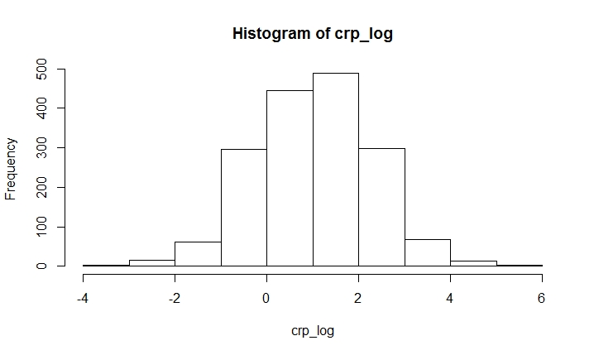
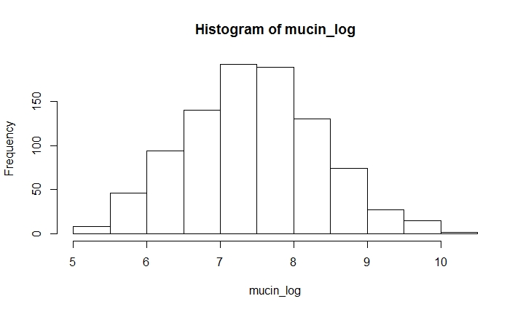
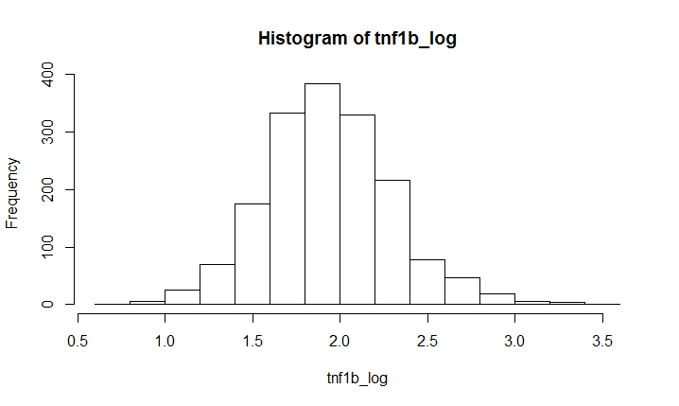
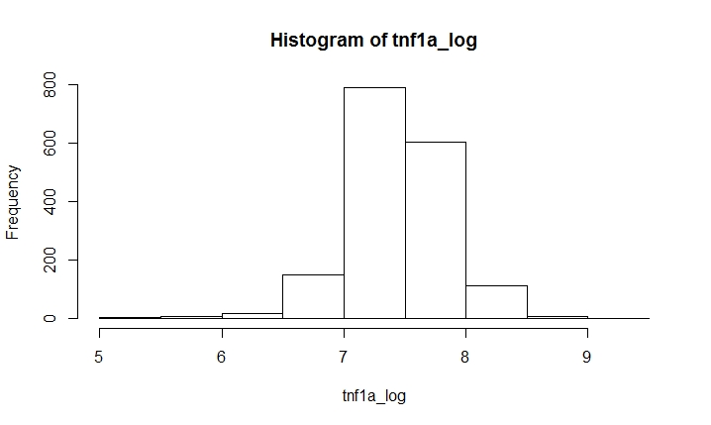

Slide 8
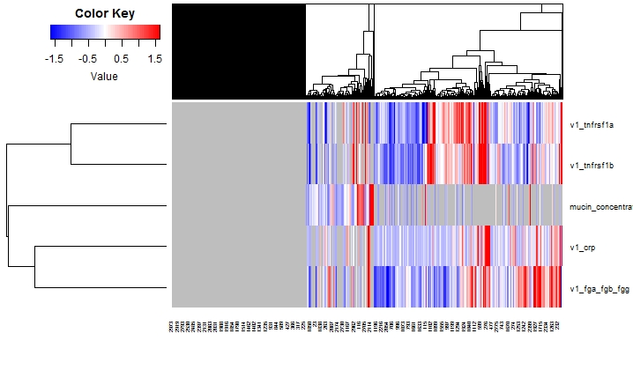

Slide 9
Demographics

Slide 11
Results
There was no statistically significant difference in the average number of cigarettes smoked per day between the smoking groups
Resilient smokers were distinguished from non-resilient smokers by
Lower pack years (38.5 pack- years vs 45.15 pack-years, p=0.003)
Lower mean age at which they stopped smoking cigarettes (49 years vs 52 years, p=0.01)

Slide 12
Biomarkers
There was no statistically significant differences in CRP, sputum mucin, fibrinogen, TNF1a, and TNF1b in Never Smokers compared to Group 1/Resilient smokers (Preserved Spirometry with NO evidence of symptoms or radiographic features)
Both in univariate and multivariate models
Soluble TNF1a and TNF1b became were not statistically different in all levels of smokers compared to never smokers when the model adjusted for age and cigarette pack years

Slide 13
Discussion
Resilient smokers have inflammatory biomarkers that are similar to never smokers
Could explain the preserved physiology, with lack of symptoms and radiographic findings of COPD
Group 1/Resilient smokers may be an important sub-population to further investigate
Limitations:
SPIROMICS may lead to a biased study population, volunteers
Future directions:
Protective and homeostatic biological mechanisms that leads to resilience
Airway epithelial gene expression markers
Endobonchial gene expression
Microbiome data

